Slide 1















Interview with AI
Presented by Saalim

Slide 2

Origin of the creative idea
Fed up with automated rejection emails? Our product doesn’t solve that but at least works on solving it.
The goal of the product is to provide personalized feedbacks for every candidate which will not be ideal in a human based interview. Leveraging the power of AI to avoid biased, unsatisfactory interview processes and help us improve with providing us feedbacks on the areas we can improve and also, letting us know where we excel.

Slide 3
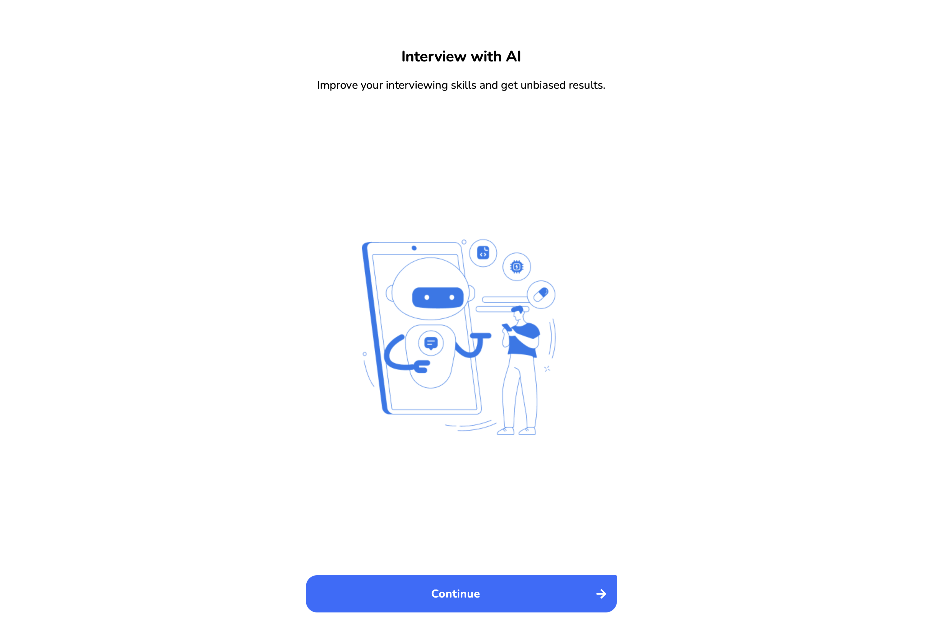

Slide 4
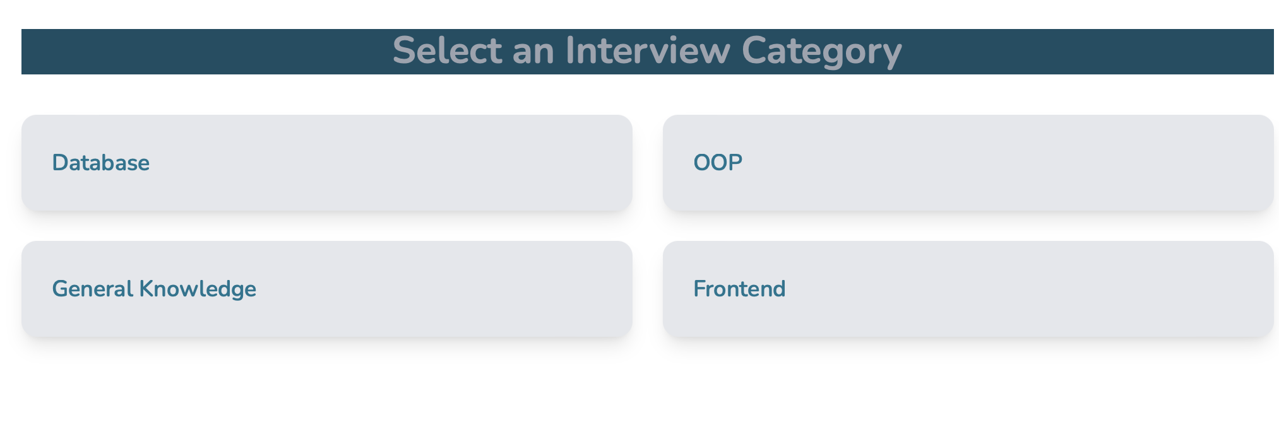
Interviews for Different Roles

Slide 5
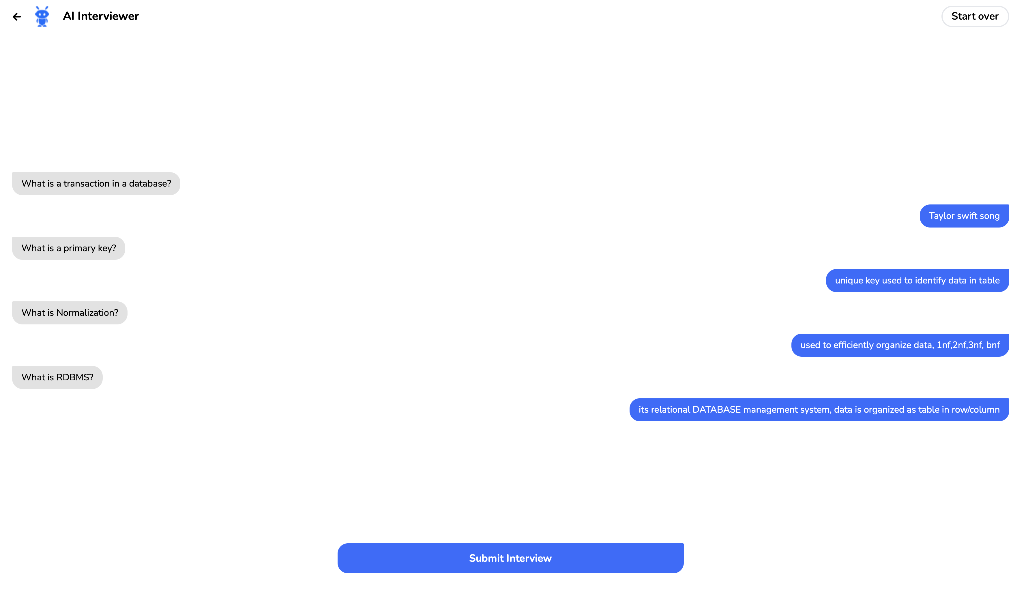

Slide 6
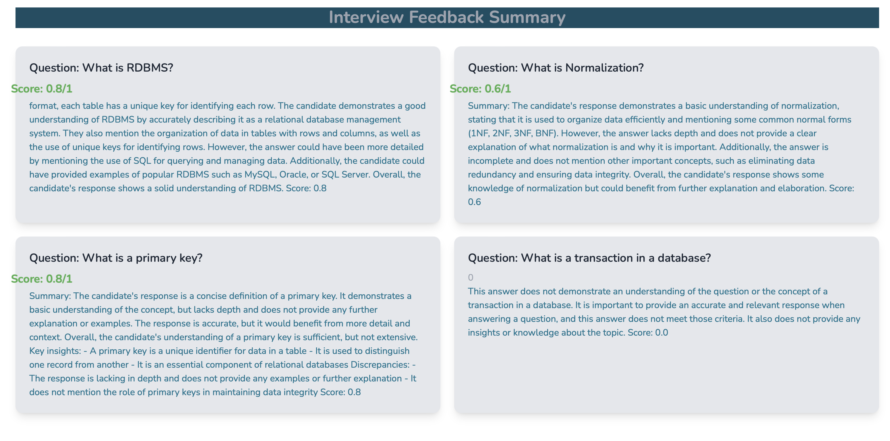

Slide 7
Response from Backend
{1: "\nSummary: The candidate's response is significantl…dence/similarity score for this comparison is 0.\n", 2: '\nSummary: The candidate has grasped the key concep…response would be approximately 0.7. \n\nScore: 0.7', 5: "\nSummary:\nThe candidate's response is significantl…in this area. \n\nConfidence/Similarity Score: 0.2 "}
1
:
"\nSummary: The candidate's response is significantly different from the original answer and does not demonstrate a grasp of the technical concepts. The candidate's response is too general and lacks depth. The candidate has not provided any additional insights compared to the original answer. The confidence/similarity score for this comparison is 0.\n"
2
:
"\nSummary: The candidate has grasped the key concepts of the terms \"poly\" and \"morph\" but their understanding is not as in-depth as the original answer. They have provided a concise definition for both terms but have not elaborated on their meanings or provided any additional insights. The candidate's response is similar in context to the original answer, but it lacks the depth and detail that the original answer provides. The confidence/similarity numerical score for the candidate's response would be approximately 0.7. \n\nScore: 0.7"
5
:
"\nSummary:\nThe candidate's response is significantly different from the original answer. While the original answer discusses assessing understanding of technical concepts in an interview, the candidate's response simply states \"process of making data modules.\" This does not demonstrate a strong understanding of the question or the topic at hand. The candidate does not mention any specific technical concepts or provide any additional insights. It is clear that the candidate has not grasped the key concepts and lacks depth of understanding in this area. \n\nConfidence/Similarity Score: 0.2 "

Slide 8
Tech Stack:
ReactJS
TailwindCSS Flask
OpenAI
CORS
Vercel
Heroku

Slide 9
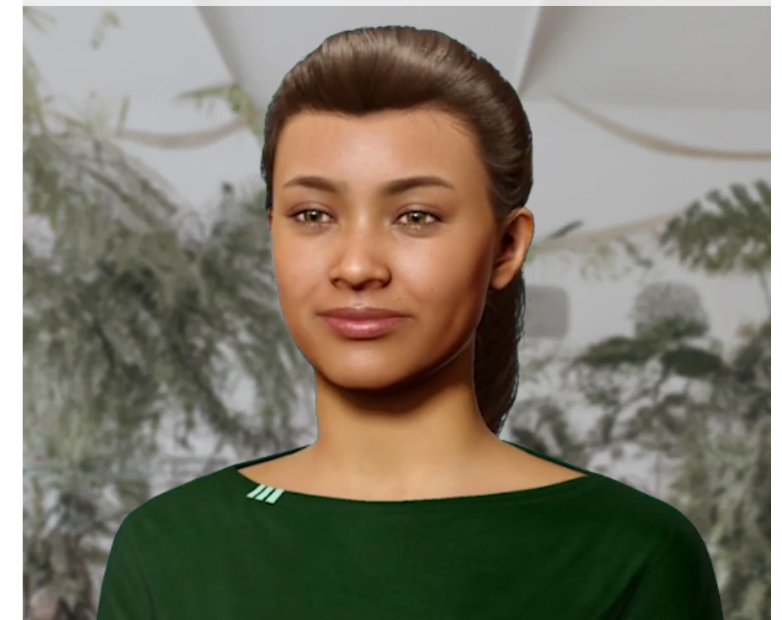
Final reflections and future steps
We can integrate with 3rd party APIs for providing a simulation on AI conducting interviews.
We can also configure the plugins to enable emotions displayed in the digital human.

Slide 10
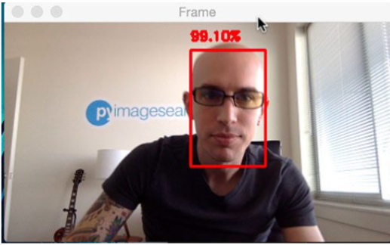
Final reflections and future steps
We can utilize computer vision technologies to employ features like detecting confidence levels, body language using sentiment-analysis.

Slide 11
Deployed in Vercel & Heroku (backend api)
Check out

Slide 12
Thank you

